Slide 1



SENTIMENT STREAM, INC.
SENTIMENT & SUMMARY:
YOUTUBE
SHANE THOMAS - 101521193
RENISH SAMIR KHIMANI - 101471380
SEYED AMIR KIARASH ABBASI - 101388487
PARUHANG ANGDEMBE - 101493134

Slide 2
Demo

Slide 3
Problem Statement: Sentiment Analysis Tool
Current Gap in Capabilities:
Lack of automated tools to promptly and accurately analyze vast volumes of YouTube comments.
Inefficiency in manually monitoring and responding to user feedback, which is both time-consuming and prone to errors.
Impact on Business Operations:
Delayed response to viewer sentiments leading to missed opportunities in real-time content optimization.
Inability to quickly adapt to changing viewer preferences, resulting in lower engagement and satisfaction rates.
Speed and Convenience Needs:
Need for a solution that can process and analyze comments in real-time to provide immediate insights.
Requirement for an intuitive, user-friendly tool that integrates seamlessly with existing content management workflows, minimizing disruption and learning curve.
Risk Factors:
Slower reaction times to negative feedback can escalate into larger issues, potentially harming viewer relationships and brand reputation.
Manual data handling risks data errors and inconsistencies, which could misinform content strategies and business decisions.

Slide 4



Financial Plan
Daily Costs:
Cost Per Day: $5.84
Monthly Cost Calculation: $5.84 x 30 = $175.20 per month
Subscription Revenue Model:
To determine a viable subscription price, consider both coverage of operational costs and potential profit margins. A price point of $200 per month, for example, could be effective if the operational cost per user is approximately $175, allowing for profitability based on the service's value and market competition.
Advertisement Revenue Model:
Calculate potential monthly ad revenue based on your website traffic and prevailing ad rates. Utilize industry benchmarks such as CPM (cost per thousand impressions) or CPC (cost per click) to estimate earnings.
Risk Analysis and Management:
Assess risks such as fluctuating subscriber numbers or lower-than-expected ad revenue.
Plan for contingencies such as cost-cutting measures or alternative revenue strategies.
Break-Even Number of Subscribers Calculation:

Slide 5
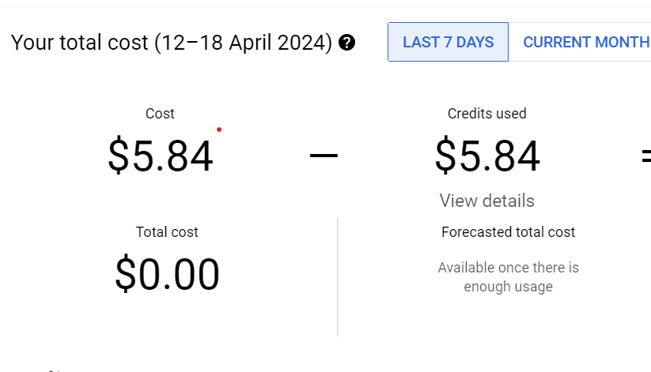
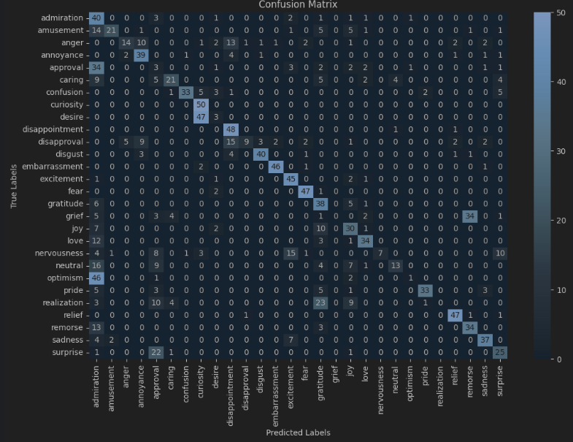
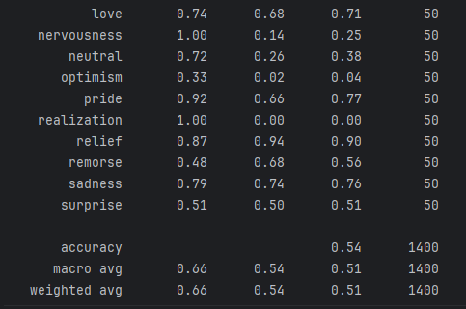
Model Benchmarking & Cost

Slide 6
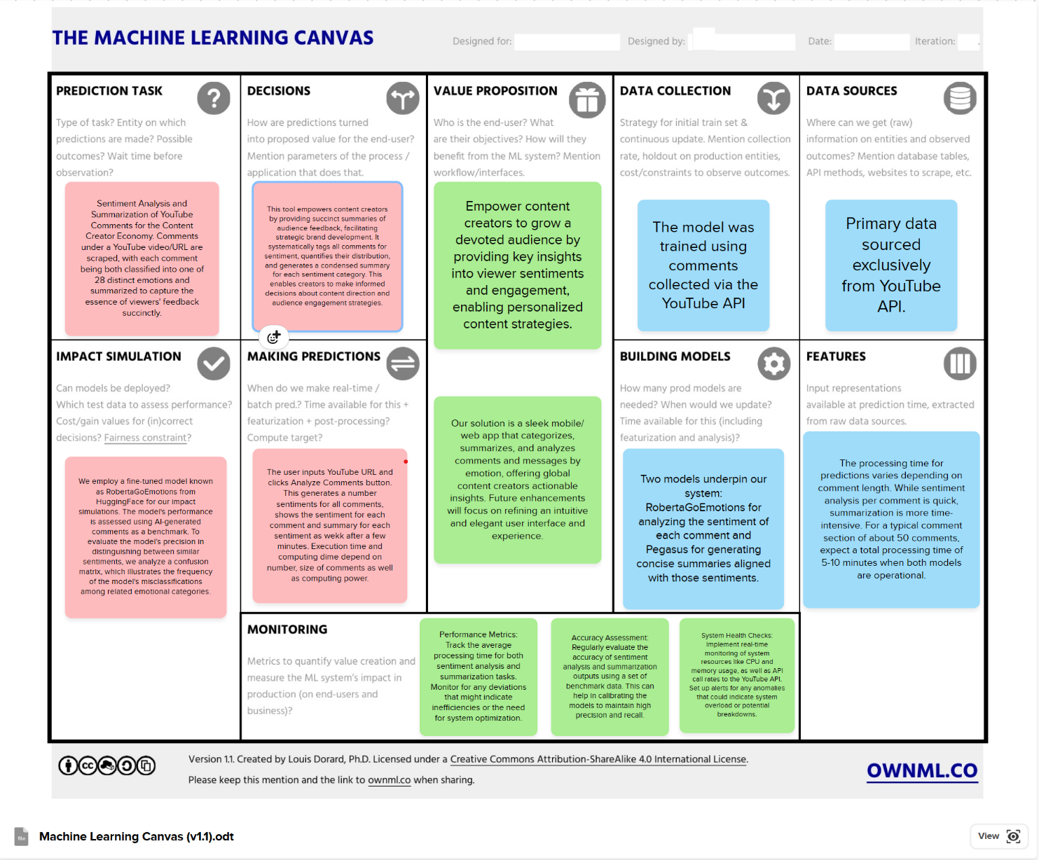
ML Canvas

Slide 7
Model Deployment & its Challenges + Issues encountered
Notebook --> Script
Script --> Flask / fastapi / …
Docker
Host in google cloud

Slide 8
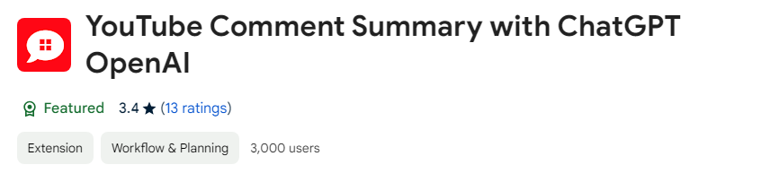
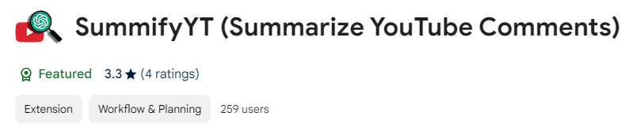
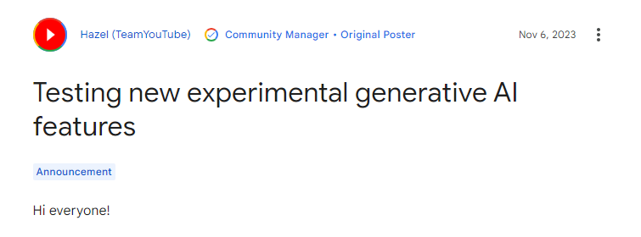
Competitors

Slide 9
Literature Review
Past Projects on Sentiment Analysis & Summarization Guided us
Pretrained Models Roberta and Pegasus
YoutubeAPI, Flask API, Google Cloud, ChatGPT API
The model is quite slow in terms of the summarizer using Pegasus

Slide 10
Future Implementation
Chat GPT API - Summarizer
More Buttons for more flexibility and speed
Having Periodic Update with sample data from youtube to Finetune Models
Expanding service to other websites and even live chats

Slide 11
Q & A

